Slide 1
Application of Conformal Prediction (CP) and Quantile Regression (QR) for the PNBD model
Supplement to my Master‘s thesis „Uncertainty in time-series modeling: An application to the prediction of individual customer lifetime values“

Slide 2
Conformal Prediction (CP)

Slide 3
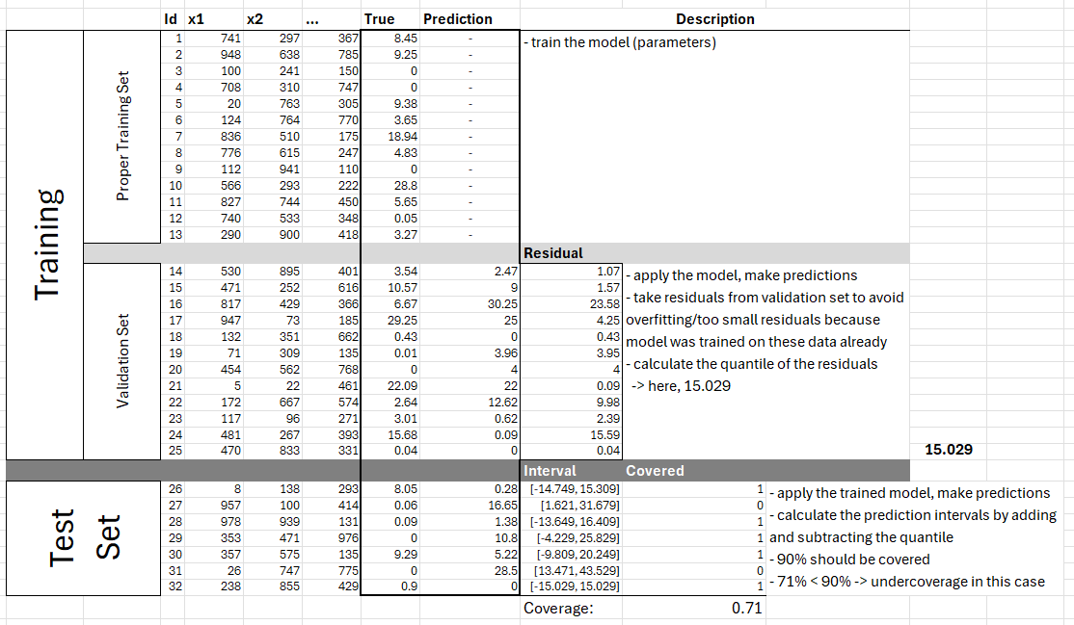
General Procedure (no pnbd-context)
1.
2.
3.

Slide 4
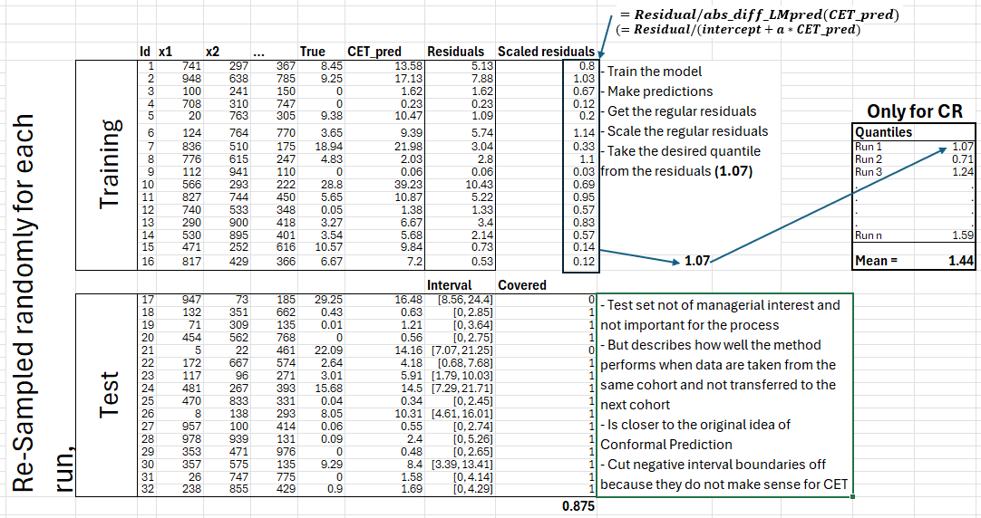
Applied in pnbd-context (Part 1, old cohort)
Temporal transfer of the quantile

Slide 5
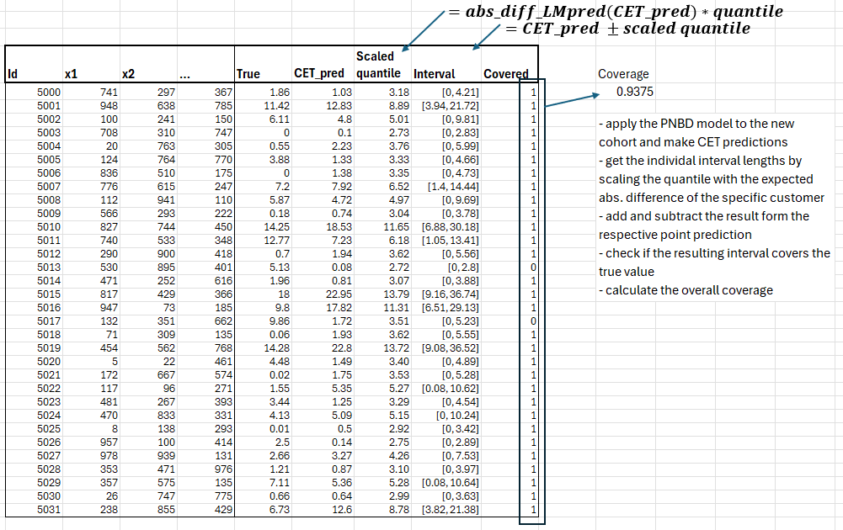
Applied in pnbd-context (Part 2, new cohort)

Slide 6
Quantile Regression (QR)

Slide 7
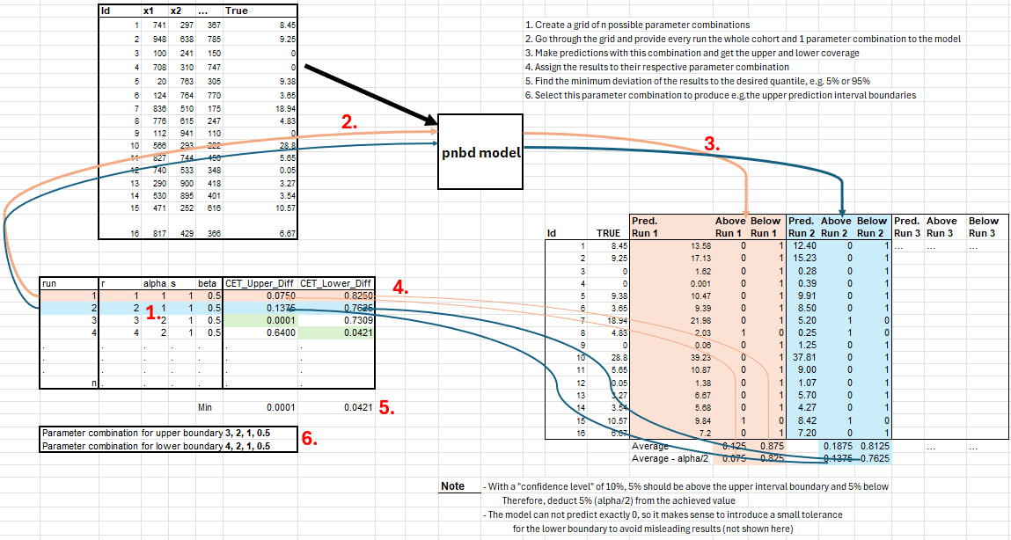
Applied in pnbd-context (Part 1, old cohort)

Slide 8
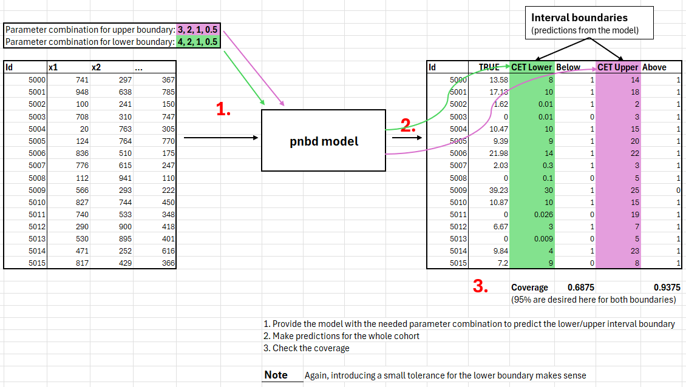
Applied in pnbd-context (Part 2, new cohort)

